Slide 1
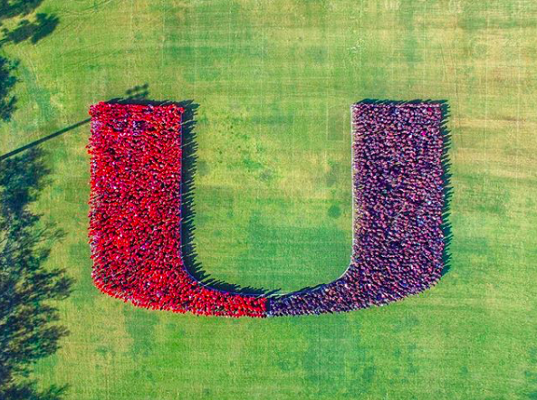
College of Engineering
Spring 2020
Graduate Orientation

Slide 2
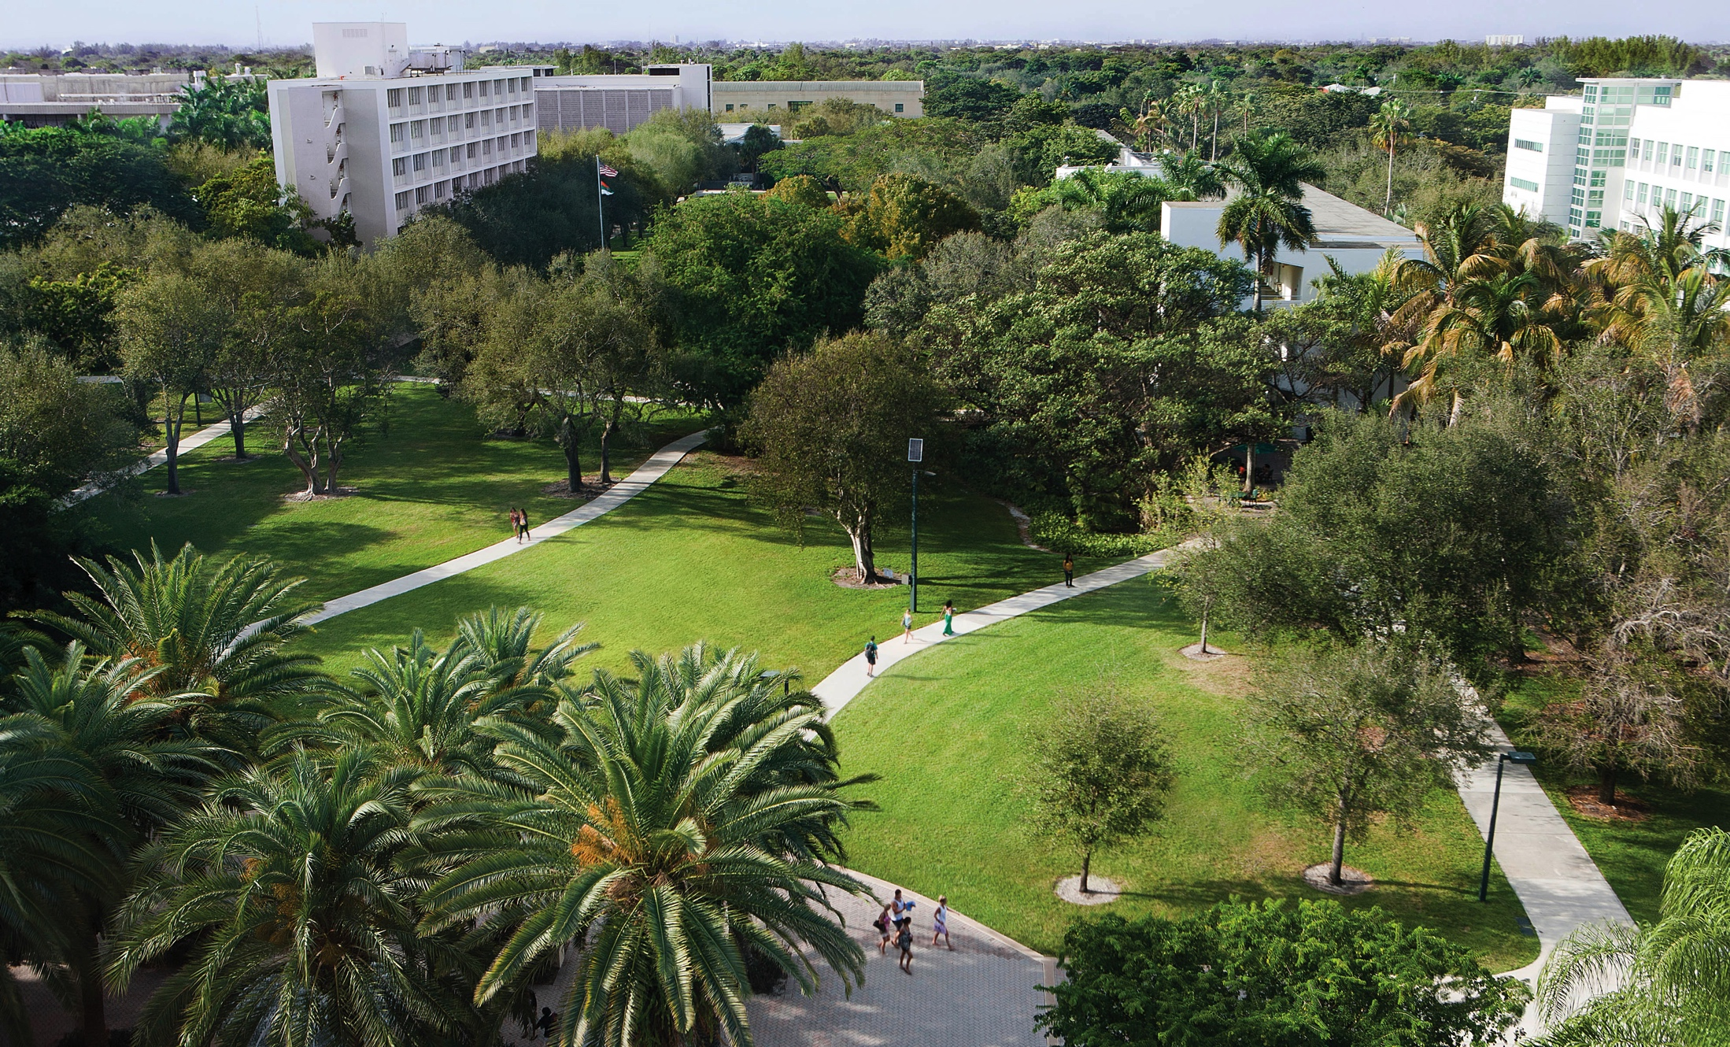

At the U, we lives
research,
transform
through
education,
innovation,
and
service.

Slide 3
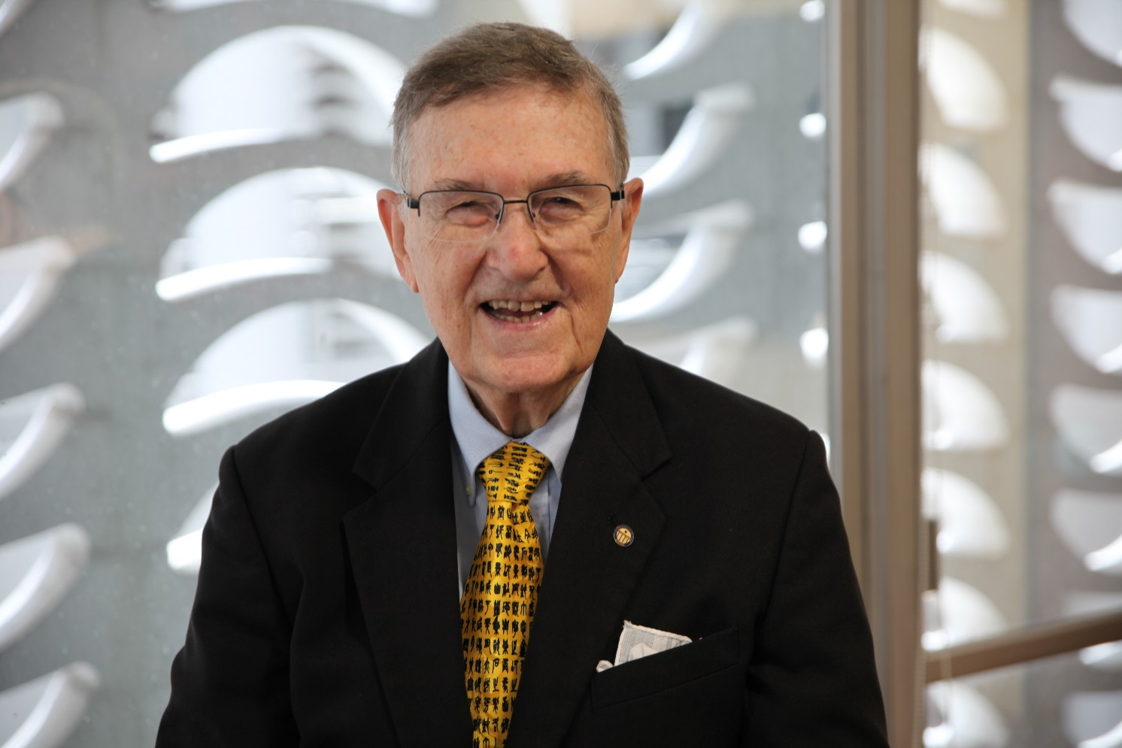
WELCOME
Dean Daniel Berg
UNIVERSITY OF MIAMI
COLLEGE of ENGINEERING
Transforming Lives Through Education, Research, Innovation and Service

Slide 4
College of Engineering
Safety First!
Spring 2020
Graduate Orientation

Slide 5
Welcome
College of Engineering
Graduate Student Orientation
UNIVERSITY OF MIAMI
COLLEGE of ENGINEERING
Transforming Lives Through Education, Research, Innovation and Service

Slide 6


Graduate Engineering Student Council (GESC)
Tarika Sankar, President
Graduate Student Association (GSA)
UNIVERSITY OF MIAMI
COLLEGE of ENGINEERING
Transforming Lives Through Education, Research, Innovation and Service

Slide 7
CoE Graduate Student Orientation
Department Chairs and Graduate Program Directors
BME: Dr. Manns and Dr. Ziebarth (Dr. Zhao, Medical Physics)
CAE: Dr. Nanni and Dr. Giancaspro (Dr. Andiroglu, Construction Mgt)
ECE: Dr. Abdel-Mottaleb and Dr. Premaratne
IEN: Dr. Omachonu and Dr. Erkoc
MAE: Dr. Coverstone and Dr. Yang (Dr. Zha, Ocean Engineering)
Dean’s Office (consistency check)
MS admissions: David Poole, Director of Admissions, dtpoole@miami.edu
Graduate research: Helena Solo-Gabriele, Ph.D., P.E., Professor and
Assoc. Dean, Research, hmsolo@miami.edu
Graduate academics: Derin Ural, Ph.D., Professor of Practice and
Assoc. Dean, Student Affairs, dnu3@miami.edu
UNIVERSITY OF MIAMI
COLLEGE of ENGINEERING
Transforming Lives Through Education, Research, Innovation and Service

Slide 8
Getting Started
  Basics (talk to fellow students)
  SS# (if employed by Department)
  Course Registration
  Program of Study (list of courses that count towards your degree)
  Program or Research Committee Chair. Committee Members (3 for MS, 4 for PhD, min., chair inclusive)
  Program requirements. Read 2020 to 2021 bulletin http://bulletin.miami.edu/
  http://bulletin.miami.edu/graduate-academic-programs/
  http://bulletin.miami.edu/graduate-academic-programs/engineering/
  Departmental sections

Slide 9
Getting Started
NEW Student Information
CURRENT Student Information
  Orientation
  Housing
  Health Insurance
  Tuition and Fees
  Parking and Transportation
  Visa (I-20)
  General (Search www.miami.edu)
Bulletin (http://bulletin.miami.edu/)
Graduate Student Handbook (https://www.grad.miami.edu/index.html)
Engineering Policy for Students Receiving Financial Offers (Read letter and addendum (http://www.coe.miami.edu/research-2/for-graduate-students/)
BME has a handbook
(See Dr. Ziebarth)

Slide 10
CoE Research
• Smart, Sustainable and Resilient Systems (Smart City)
• Health Care Engineering and Medical Decision-Making
• Big Data Analytics and Cybersecurity
Materials and Additive Manufacturing
https://www.coe.miami.edu/research/research-day/first-annual-research-day/index.html

Slide 11
Training
  CoE Researchers (All PhD and MS/ugrad conducting research)
    Training in Responsible Conduct of Research, Item in “to do” list in Canelink. (http://www.coe.miami.edu/research/responsible-conduct-of-research/)
      Three requirements
      On-line CITI Training. See above link for instructions
      Workshop
      Professional Development Events Covering RCR
    Two-part process in Conflict of Interest. (https://www.uresearch.miami.edu/uresearch-services/disclosures-and-relationship-management-drm/index.html)
      The first part is an on-line training module in conflicts of interest.
      The second part is completing a disclosure.

Slide 12
Training
  Lab safety – Office of Environmental Health and Safety. (http://business-services.miami.edu/departments/ehs/index.html)
  Teaching Assistants whose native language is not English →Speak Test. More information is available through the Intensive Language Institute (305-284-2752).

Slide 13
Training Specific to PhD Students
  Ph.D. student teacher training program (Detailed in Offer Letter)
    Mentored teaching experience
    Blackboard course
    Assist faculty in developing a course Blackboard page
  All new PhD students, regardless of their initial assignment, are to complete TA training

Slide 14
Offer Letters (PhD students)
Signed by Department Chair
Specifies
  Duration of support
  Total tuition award
  Stipend and tuition for current year
  Conditions for continued support

Slide 15
Conditions of Continued Support
Satisfactory progress towards degree
  Cumulative GPA of 3.3
  Qualifying exam in first academic year
  Satisfactory reviews in TA duties
  Satisfactory progress in research
  Satisfactory attendance in CoE Speaker Series and Departmental Seminars
  Add’l requirements as per letter

Slide 16
Health Insurance
Sign up for 80% credit through myUM (https://studenthealth.studentaffairs.miami.edu/index.html)
Vacation/Holidays
About 9-10 days of holidays and 9-10 days of vacation. Must get OK from Department Chairs and research advisors for specific days

Slide 17
Outside Employment
No employment permitted outside of Dept. or University
Tuition Usage
Spread out 800 level thesis courses to remain in full-time status for duration of program. Additional tuition for research- in-residence will not be provided.

Slide 18
In Summary
Meet with Dept. Graduate Program Director
Meet with Research Advisor
Department Chair and Staff
Be part of Graduate Engineering Student Council (GESC) and Graduate Student Association (GSA)
GSA President, Tarika Sankar (tgs46@miami.edu)
Take part in what CoE has to offer
PhD students: Read offer letters and addendum carefully.
UNIVERSITY OF MIAMI
COLLEGE of ENGINEERING
Transforming Lives Through Education, Research, Innovation and Service

