Slide 1
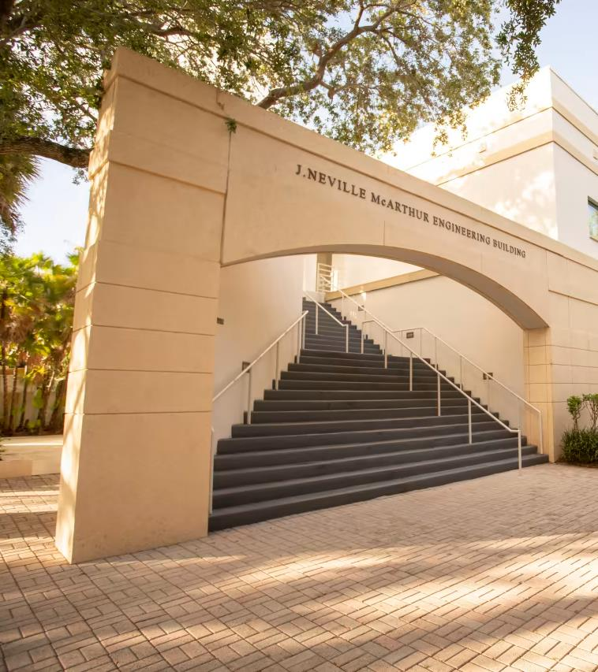

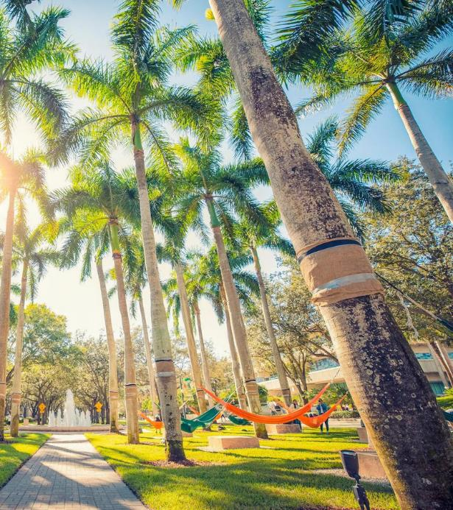



Welcome
Engineering Graduate Student Orientation
Connect with us!
@umiamiengineering

Slide 2
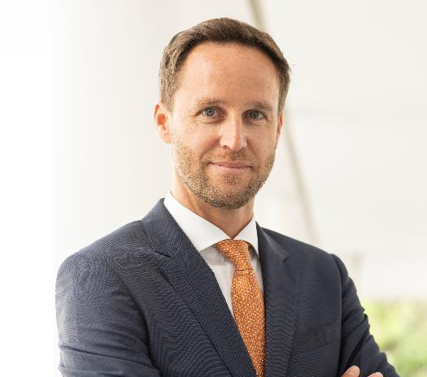
Jan Macko
Director of Admissions College of Engineering
jmacko@miami.edu
Notes:
Kaitlin to introduce Jan Macko

Slide 3
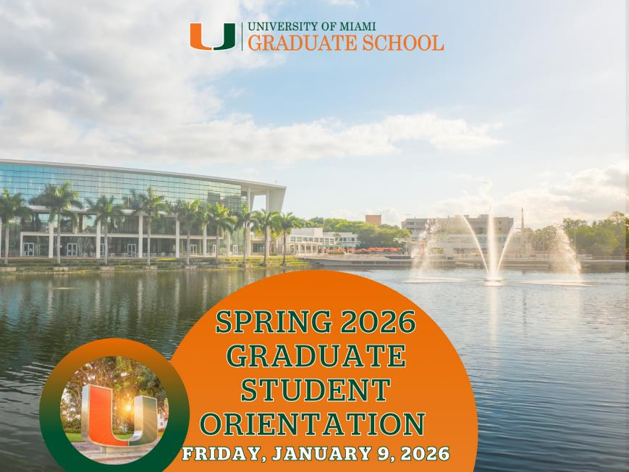
Additional Orientation Sessions
International Students
International Student Orientation by ISSS
Friday, 9:00 AM – 12:00 PM
@Shalala Student Center Activities Room (3rd Floor)
All Graduate Students
Graduate Students Orientation
Friday, 12:00 PM – 2:30 PM
@Lakeside Village Expo Center

Slide 4
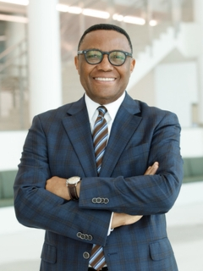
Vincent K Omachonu, Ph.D.
Interim Dean of College of Engineering
Professor and Chair, Industrial Engineering
vomachonu@miami.edu

Slide 5

Welcome New Graduate Engineering Students
New 2025-26 Graduate Class
133 Students
36 PhD Students
97 MS Students
25 % International
17 Countries Represented
25 U.S. States Represented
Top Foreign Countries
China
Kuwait
Brazil
Colombia
India
Canada
Bangladesh

Slide 6
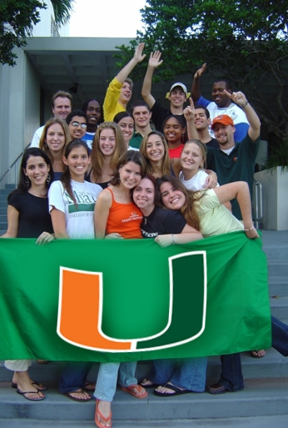




THIS is Miami Engineering
Size
Diversity
37%
Female
33%
Hispanic
13%
Asian
324
Graduate
914
Undergraduate
8%
Black
25%
Intl.
Student Awards
NIH Oxford-Cambridge
Scholars Program
…and more!
Faculty
60
Tenure/TT
25
Educator
3
NAE

Slide 7
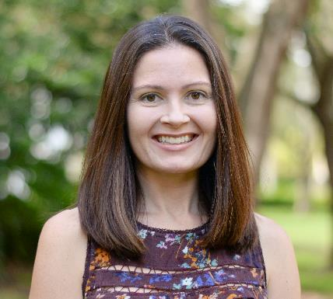
Noël Ziebarth, Ph.D.
Associate Professor of Biomedical Engineering
Associate Dean for Graduate Studies
nziebarth@miami.edu

Slide 8
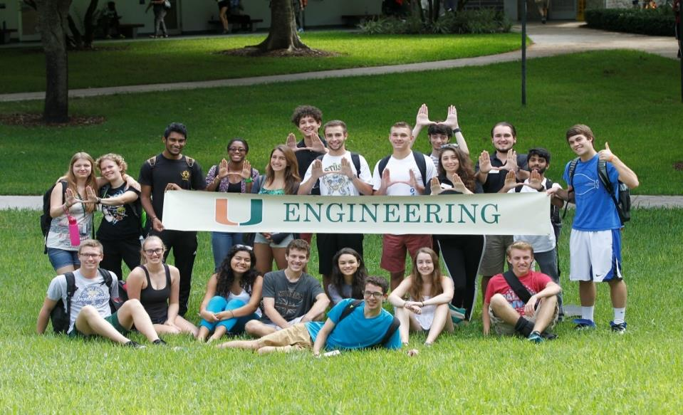
Congratulations and welcome to the University of Miami College of Engineering!

Slide 9
Engineering Academic Programs
PhD DEGREES
Biomedical Engineering Ph.D.
Chemical, Environmental & Materials Engineering Ph.D.
Civil and Architectural Engineering Ph.D.
Electrical and Computer Engineering Ph.D.
Industrial Engineering Ph.D.
Mechanical and Aerospace Engineering Ph.D.
Medical Physics Ph.D
MS DEGREES
MS degrees in all PhD disciplines
Construction Management
Materials Engineering
Neural Engineering
Ocean Engineering
Product Design
Software Engineering
Sports Engineering

Slide 10
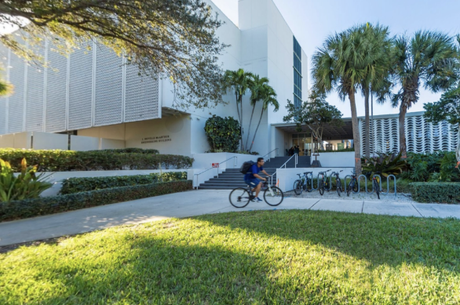
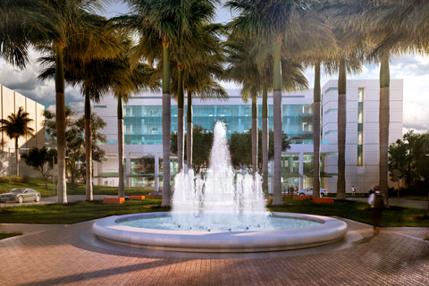
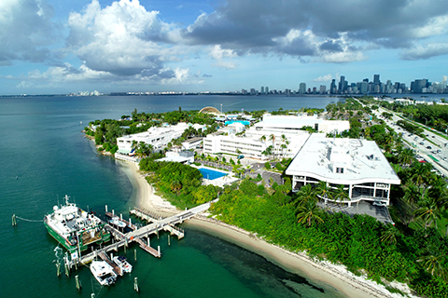
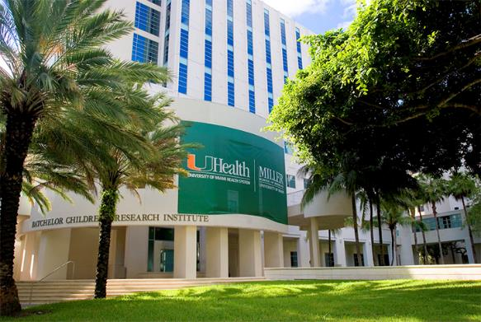
Engineering Footprint at UM
Coral Gables Campus
Marine School Campus
Medical Campus

Slide 11
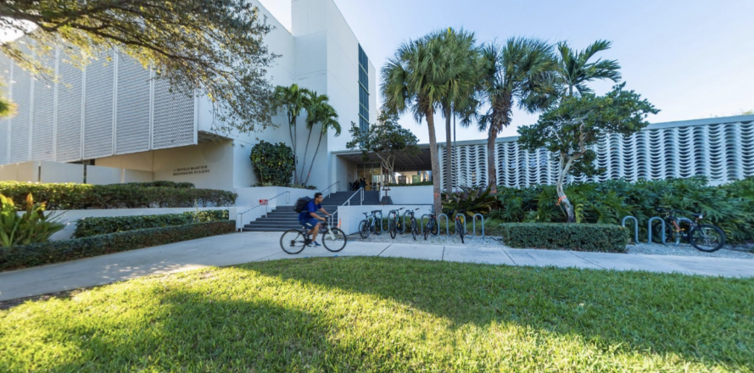
State of the Art Facilities
McArthur Engineering Building
Additive Manufacturing (MEB 1st Floor)
Materials Characterization Facility (MEB 5th Floor)
Battery Technology Facility (MEB 1st Floor)
Research Laboratories
Professional Student Workspace
Frost Institute Building
Aerosol Science and Technology (Frost)
Research Laboratories

Slide 12
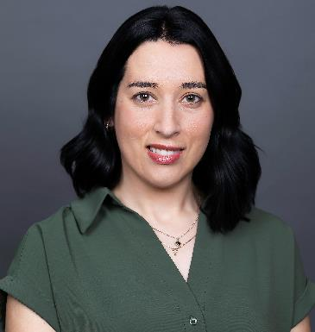
Your support team in CoE
Associate Dean for Graduate Studies
Graduate Program Coordinator
Noël Ziebarth, Ph.D.
nziebarth@miami.edu
Melody Kekez
mxk2457@miami.edu

Slide 13



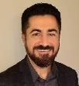

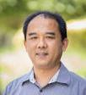












Department Leadership
Biomedical Engineering
Fabrice Manns, Chair
Alicia Jackson, GPD
Civil and Architectural Engineering
Xianming Shi, Chair
Landolf Rhode-Barbarigos, GPD
Chemical, Environmental, and Materials Engineering
Chang-Yu Wu,
Chair
Helena Solo-Gabriele,
GPD
Electrical and Computer Engineering
Industrial and Systems Engineering
Mechanical and Aerospace Engineering
Weizhao Zhao, Medical Physics
Abhishek Prasad, Neural Engineering
Pinhas
Ben –Tzvi
Chair
Sakhrat Khizroev, GPD
Vincent Omachonu, Chair
Murat Erkoc, GPD
Qingda Yang, Chair
Dibyendu Mukherjee,
Materials Engineering
Emrah Celik, GPD
Samiul Amin,
Product Design
Kamal Premaratne, MS Advising
Virender Kumar Sharma, MS CEME

Slide 14
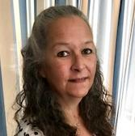
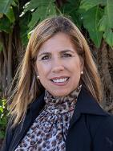
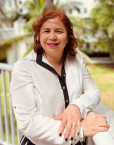
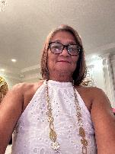
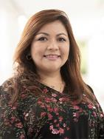
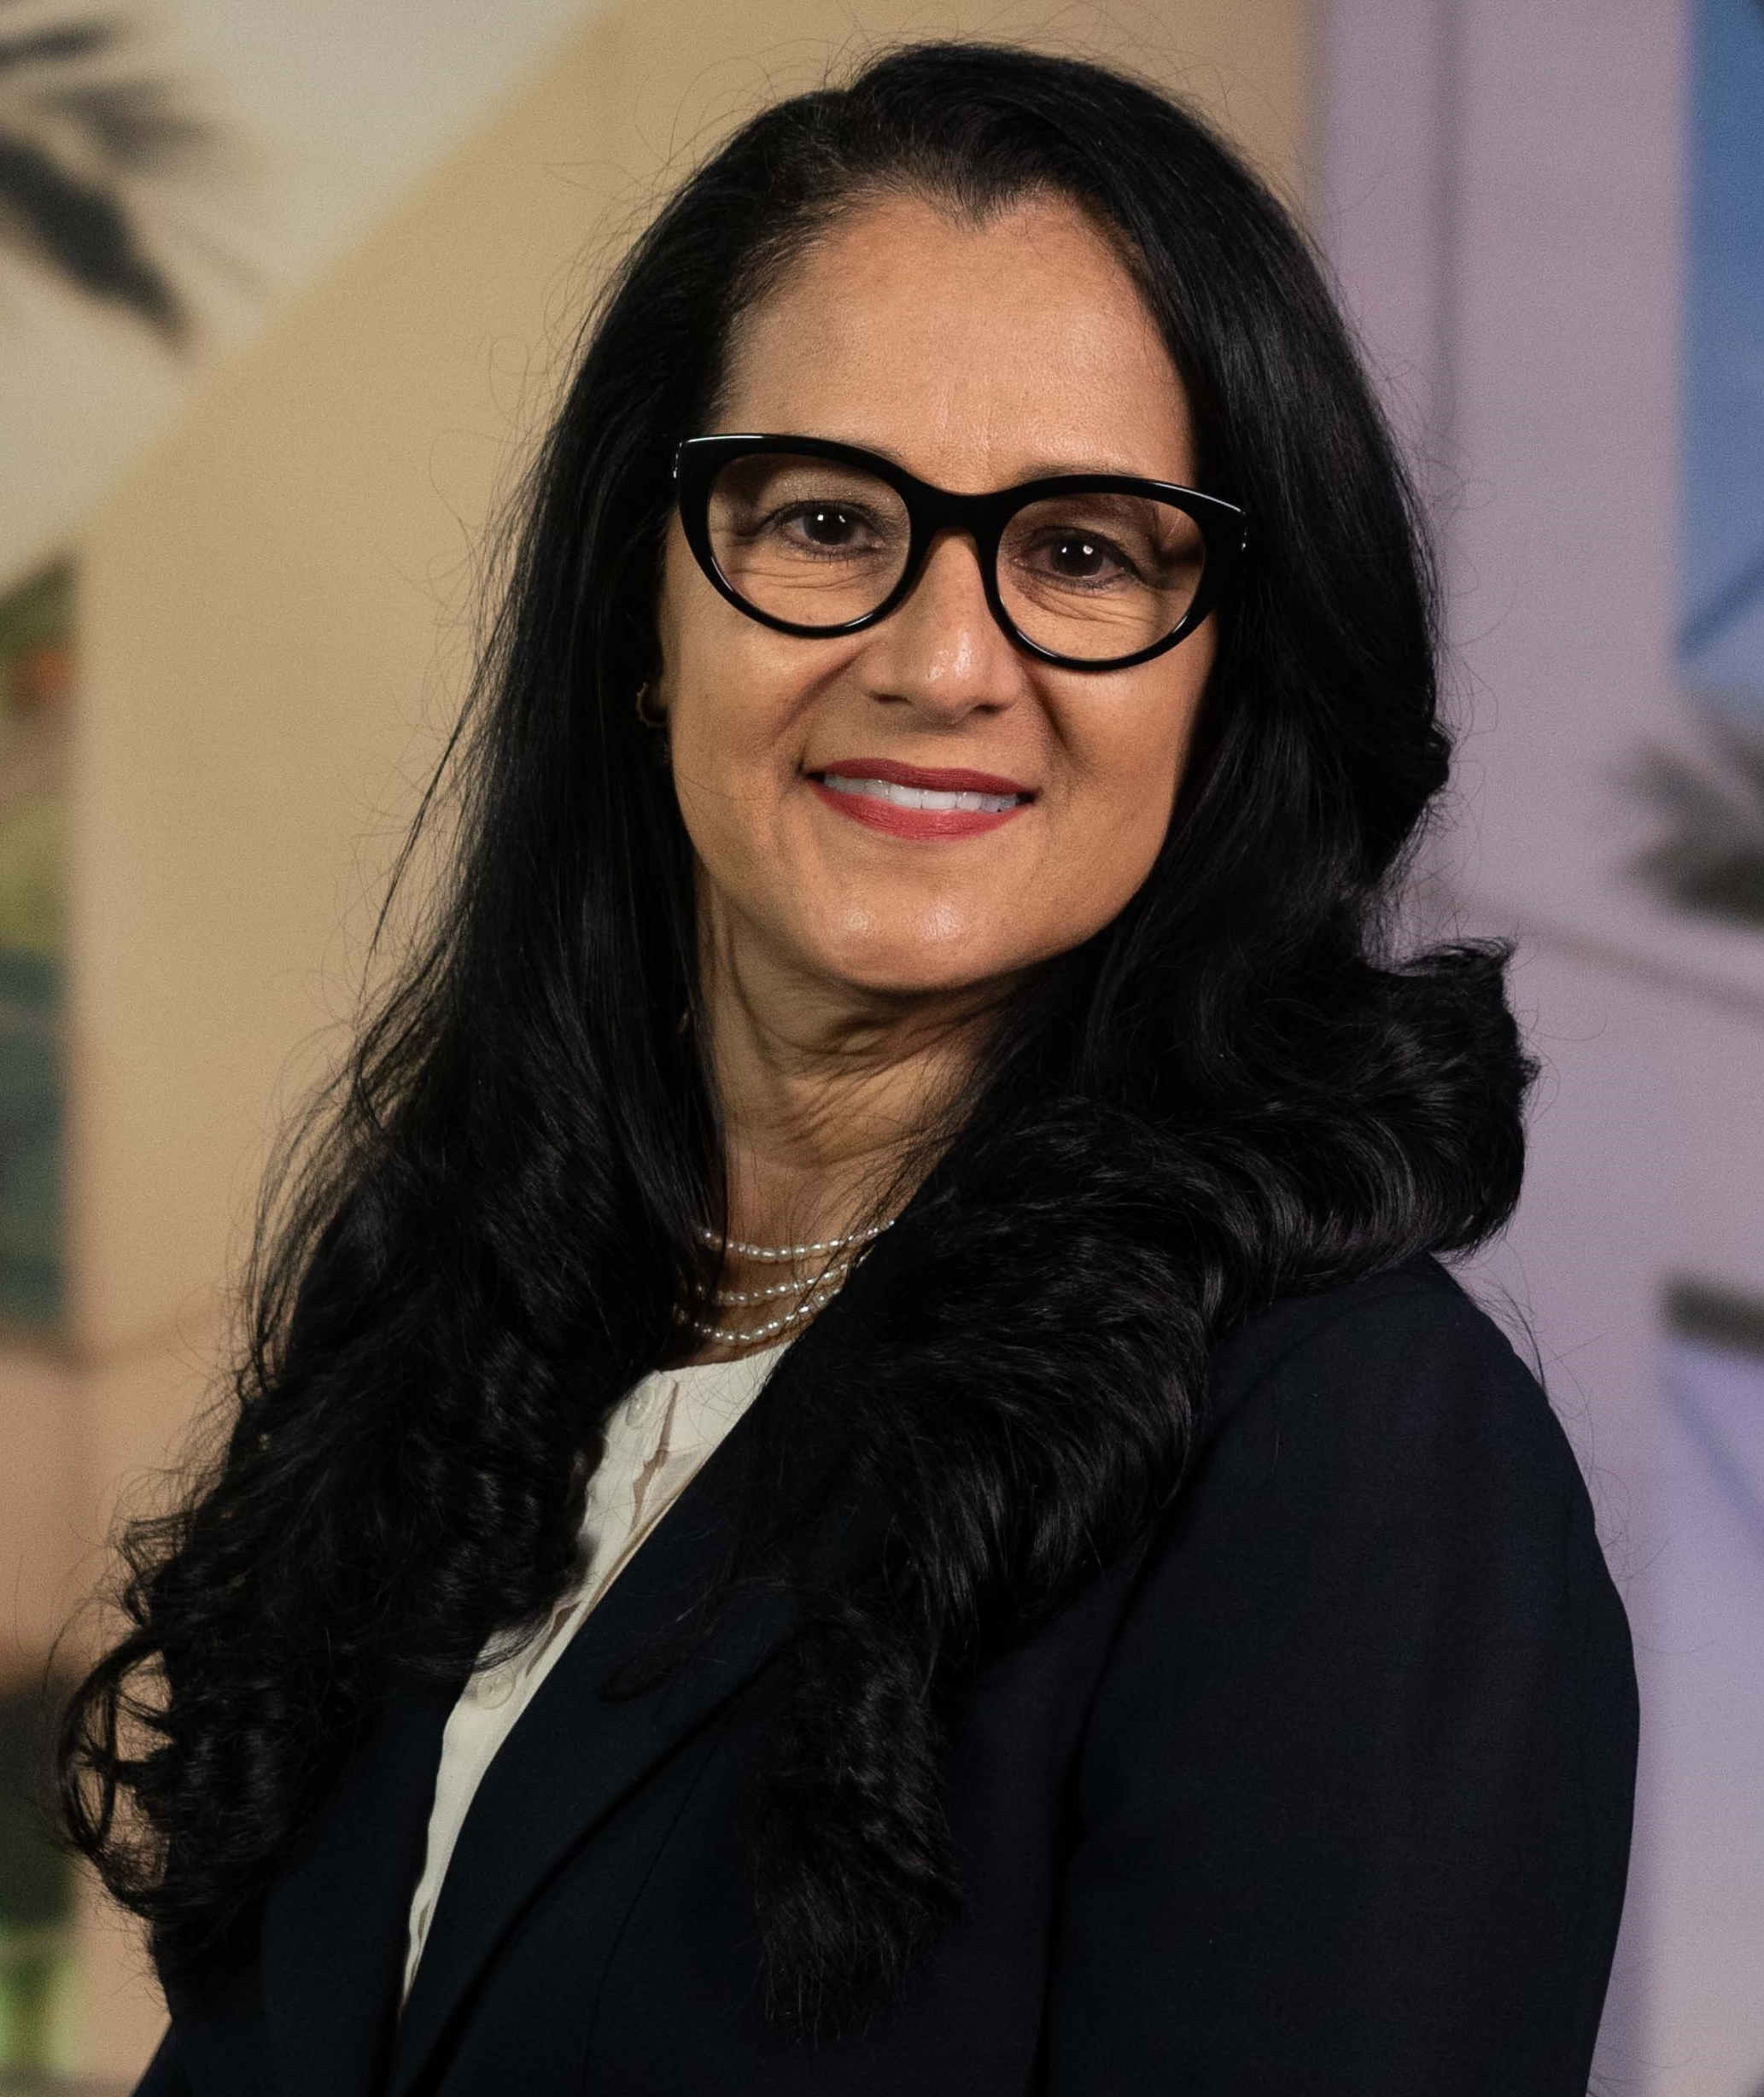
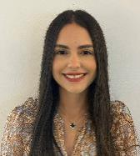
Department Staff
Biomedical
Engineering
Civil and Architectural
Engineering
Chemical, Environmental, and Materials Engineering
Electrical and Computer
Engineering
Industrial and Systems
Engineering
Mechanical and Aerospace
Engineering
Maria Hoshal
Ony Dunnham
Taimy Trujillo
Kareen Joseph
Lizett Bowen
Diana Espinosa
Elena Louit

Slide 15
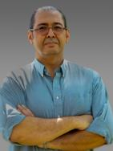
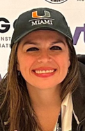



Murphy Construction Program
Program Director
Program Coordinator
Esber Andiroglu
Marcia Martinez

Slide 16



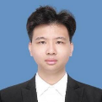


Ph.D. Advisory Council (PAC)
Biomedical
Engineering
Civil and Architectural
Engineering
Chemical, Environmental, and Materials Engineering
Electrical and Computer
Engineering
Industrial and Systems
Engineering
Mechanical and Aerospace
Engineering
Leonor
Teles
Kingshuk
Mukherjee
Amanda
Knopps
Xiaoren
Xu
Jasmine
Pattany
Yusif
Gurbanli

Slide 17
Who do you contact?
Research Mentor | Graduate Program Director | Office Staff | CoE Graduate Program Coordinator
Suggested coursework | Course registration | Salary* | Submission of official documents
Requested time off | Degree requirements | Health insurance* | Visa renewal
Research questions | TA assignment* | Tuition waivers | Events to be advertised to all graduate students
Conflict with students in lab | Qualifying exam* | Reimbursements
 | Graduate School required documents*
 | Conflict with mentor
 | Concern about professor and/or grade in course
* Relevant to PhD students only

Slide 18
Getting Started
See the CoE checklist
Attend departmental orientation (right after this meeting)
Register for courses (see Graduate Program Director)
Check-in with your research advisor
Find your way around campus
Get your parking pass and/or Metrorail pass
Attend tomorrow’s International Student and Graduate School orientations
Apply for a social security number and insurance (if employed by Department)
Talk to fellow students – don’t miss our reception right after the departmental orientation!
Complete the required Responsible Conduct of Research training

Slide 19
Responsible Conduct of Research Training
Responsible conduct of research is an important part of the foundation of the research enterprise at the University of Miami. UM has an obligation to maintain and promote a culture of research integrity and train researchers to conduct research responsibly.
All students must complete the mandatory training via Elevate:
https://elevate.miami.edu/redeem/rcr

Slide 20

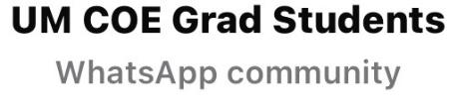

WhatsApp Community
Important announcements and events
Student Run
Various groups
PhD Departmental Groups
Housing
Academic events
Social events
International students
Create your own
Open to all COE Grad Students

Slide 21
Important Dates
January 12th: Classes begin
January 21st: Last day to add an additional course
January 28th: Last day to withdraw from a course without a “W” on your transcript
100% of tuition charge refunded
April 10th: Last day to withdraw from a course
course will show on transcript with “W”
course will not impact GPA
no refund of tuition charge
registrar.miami.edu

Slide 22
Sources of Information
Graduate School website: www.grad.miami.edu
ISSS website: www.isss.miami.edu
College of Engineering and departmental websites: www.miami.edu/coe
Departmental graduate handbook
University of Miami Bulletin: www.miami.edu/bulletin
Your offer letter (for PhD students)
Become familiar with your curriculum and your graduation requirements
When in doubt, reach out to your departmental graduate program director

Slide 23
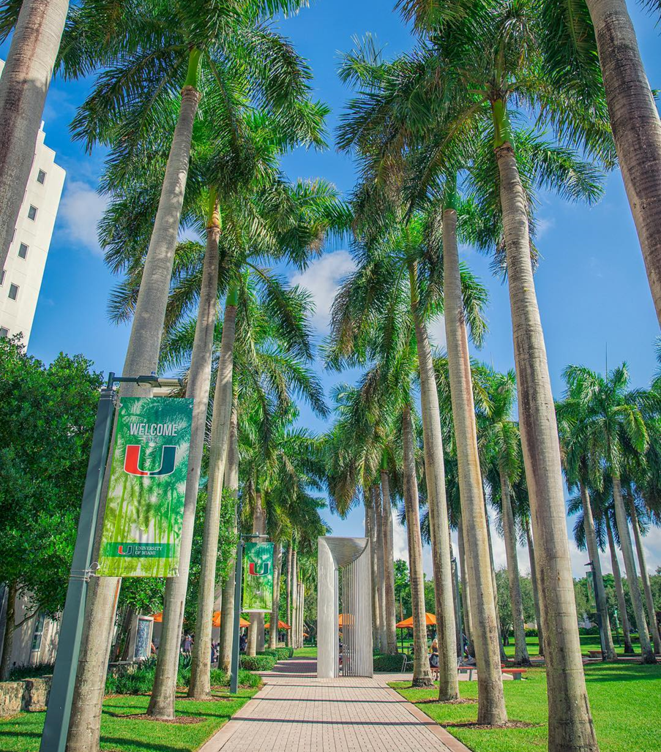
Questions?

Slide 24
Departmental Break Out Session
Reconvene in MEA 220
for reception at 4:30

